Slide 1
Khalid Songs AND Zipf’s Law Analysis
BY: Vikalp
Repo link: click me

Slide 2
THE TEAM : VIKALP
Name: Shashwat Sharma
Email : shashwat.sharma@adypu.edu.in
Name: Vaibhav Singh
Email : vaibhav.singh@adypu.edu.in
Name: Sushant Kumar Ojha
Email : sushant.ojha@adypu.edu.in
Name: Vansh Singhal
Email : vansh.singhal@adypu.edu.in

Slide 3
Understanding The Flow
The study is about khalid songs and his career along with the study of trends that a natural language follows.
Using data Analytical tools to study the data and finding patterns.
The study also includes the trends followed by the frequency of the top khalid songs
THE DATA
The data is consists of khalid’s music and album the includes following data:
Artist
Title
Album
Year
Date
Lyrics

Slide 4
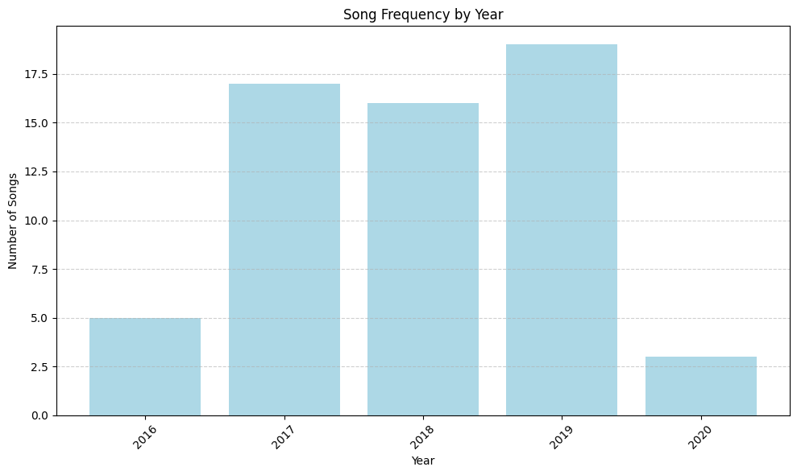
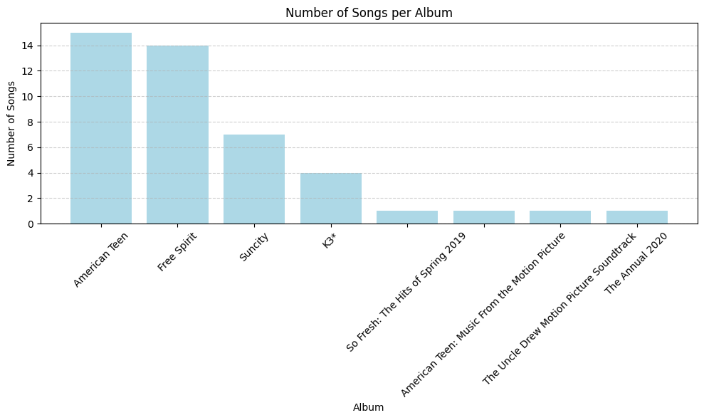
Career Analysis: (2016-2020)
Most Active year
Songs in each Album.

Slide 5
Understanding Zipf’s Law
Definition: "Zipf’s Law states that the frequency of any word in a corpus is inversely proportional to its rank in the frequency table. In other words, the most frequent word appears roughly twice as often as the second most frequent, three times as often as the third, and so on."
Relevance: "Zipf's Law is important because it reveals natural language patterns. Words like articles, prepositions, and common pronouns tend to dominate the most frequent word ranks. We can apply this to Khalid’s lyrics to see how his word choices align with general language trends."

Slide 6
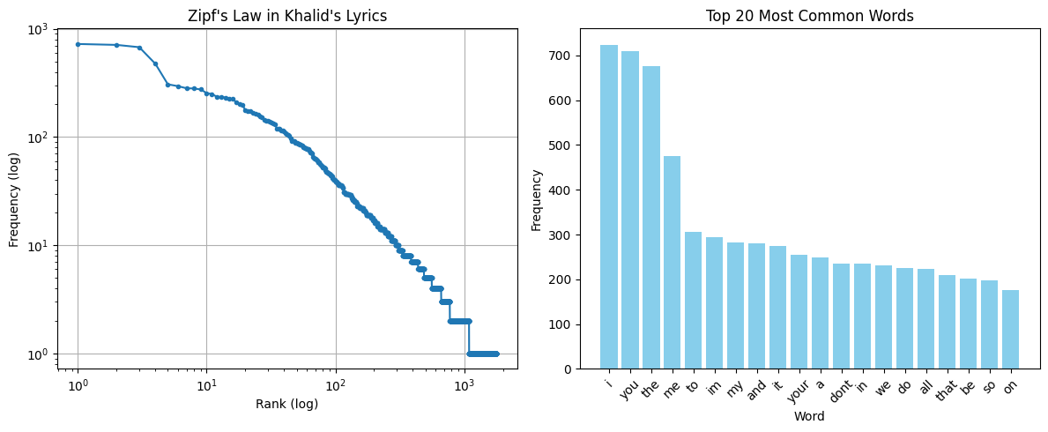
Zipf's Law & trends on Natural language
"The plot approximates a straight line on a log-log scale, showing that Khalid’s lyrics follow Zipf’s Law, with a few high-frequency words dominating the rest."

Slide 7
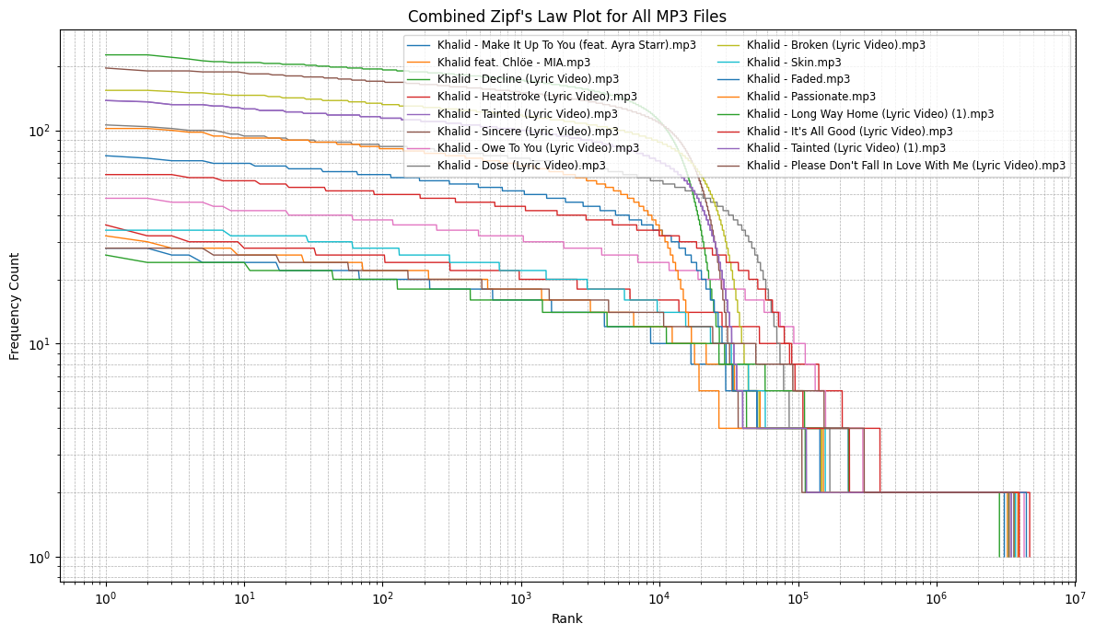
Trends on Individual song

Slide 8
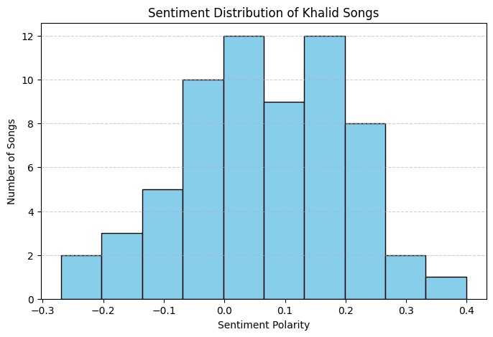
Sentiment of khalid song
Most songs fall between neutral to slightly positive sentiment.
Very few songs show strongly negative or strongly positive emotions.
Indicates a balanced and introspective emotional tone.
Lyrics likely explore themes of youth, relationships, and self-reflection.
Matches genres like Contemporary R&B and Alt-Pop.
Suggests a style that is relatable, mellow, and emotionally nuanced.
Khalid’s songs reflect emotionally balanced storytelling, aligning with the soulful and introspective nature of Contemporary R&B and Alt-Pop.

Slide 9
Findings :
Career Analysis (2016–2020):
The study covers Khalid’s music from 2016 to 2020.
It identifies his most active year and provides insights into the number of songs released per album.
Khalid’s most famous album is AMERICAN TEEN with 15 songs and most active year is 2019 with almost 18 songs
Zipf’s Law Application:
The frequency of words in Khalid’s lyrics follows Zipf’s Law, meaning a few words occur very frequently while most appear rarely.
A log-log plot of word frequency vs. rank approximates a straight line, confirming this linguistic trend.
Sentiment Analysis:
Most of Khalid's songs have a neutral to slightly positive sentiment.
Very few songs show strong emotional polarity (either highly positive or highly negative).
His lyrics often revolve around themes like youth, relationships, and self-reflection.
Genre Alignment:
The emotional tone and lyrical content are consistent with Contemporary R&B and Alt-Pop.
His music is described as relatable, mellow, emotionally nuanced, and introspective.

Slide 10
THANK YOU
We appreciate your time and attention!
This study combined music, data science, and language analysis to explore the lyrical patterns of Khalid and the relevance of Zipf’s Law in natural language.
“Keep me focused on what's real now.”
— Khalid
Thanks to the Whole Maths Team and Also GURPREET SIR for Guidance and support throughout the Course..
FROM TEAM VIKALP

